Slide 1
A basic example
Bob Verity, Pete Winskill

Slide 2
Three main inputs
Data
Parameters
Likelihood and prior functions

Slide 3
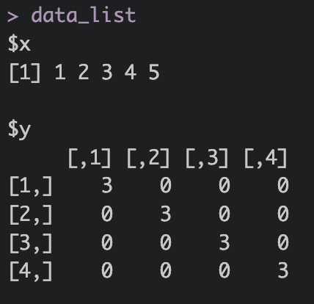
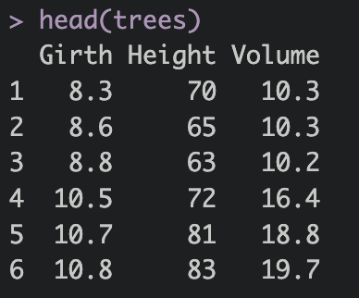
Data
Data must be in a list
A data.frame is a type of list

Slide 4
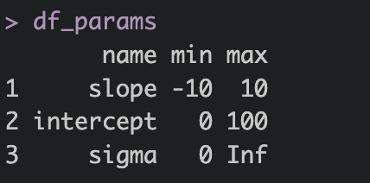
Parameters
Parameters must be in a data.frame
Must contain the columns name, min, max
min and max values are allowed to be +-infinity

Slide 5
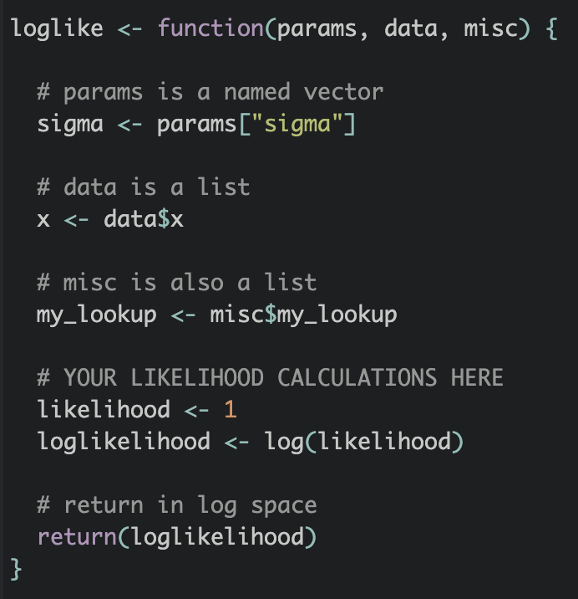
Log-likelihood function
Must have these exact input arguments
params is a named vector. Names match those defined in the parameters data.frame
data is a list
misc is a list (often left empty)
Must return the likelihood in log space

Slide 6
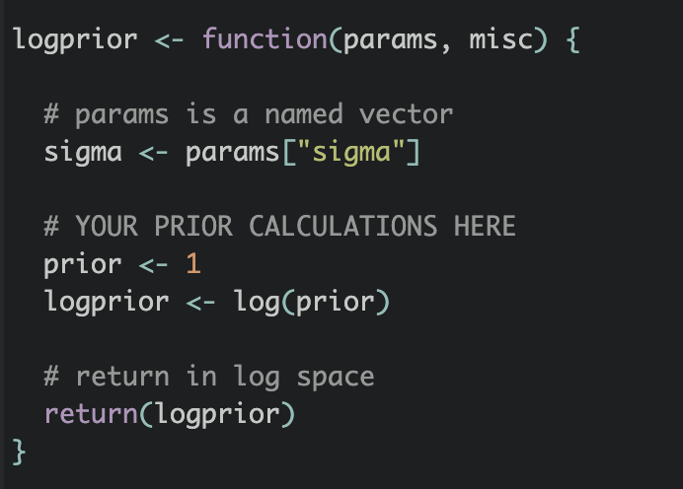
Log-prior function
Same inputs, minus data
Must return the prior in log space

Slide 7
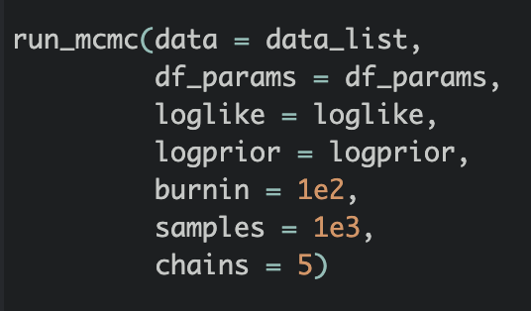
Run MCMC
The inputs we just defined
Run-time parameters

Slide 8
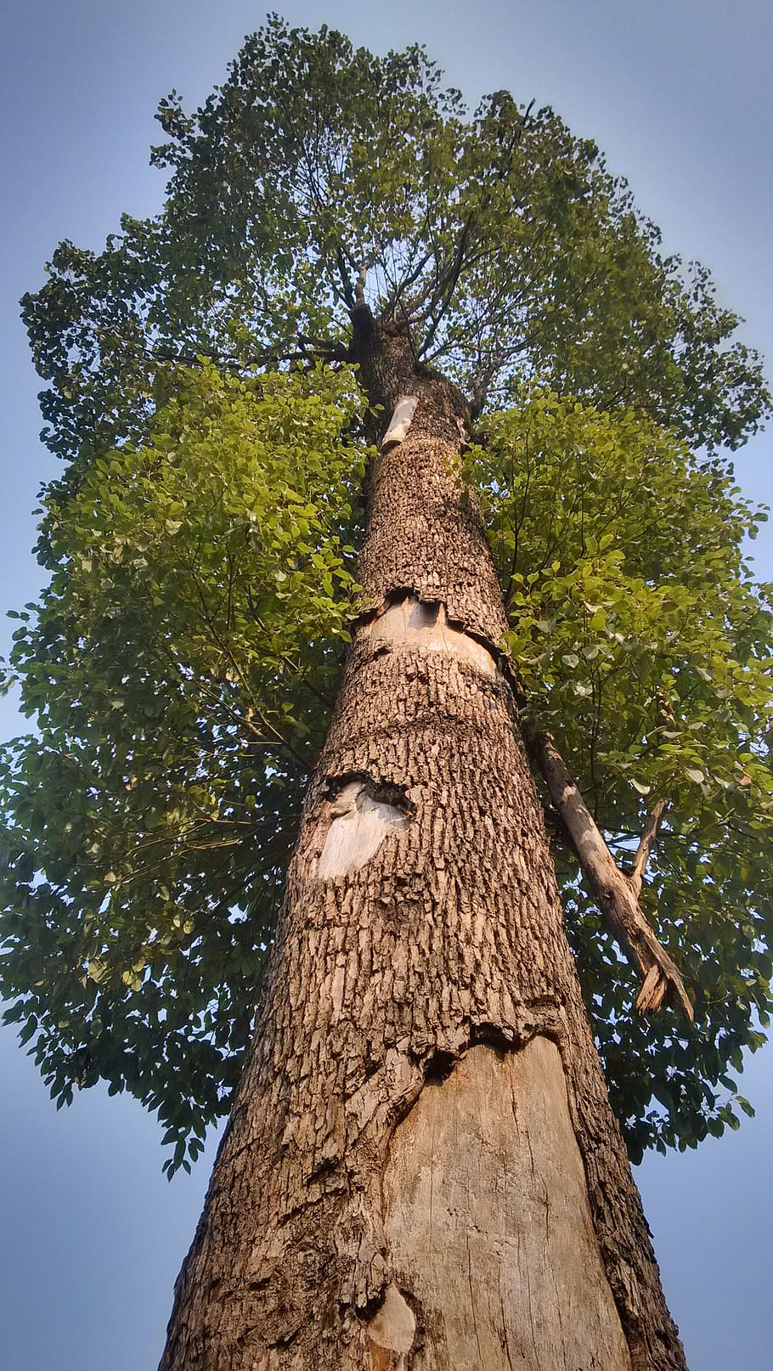
The “trees” data
Can we predict Volume using Girth?
Work through file
R_scripts/01.Basic_linear_regression.R
A tree

Slide 9
Results

Slide 10
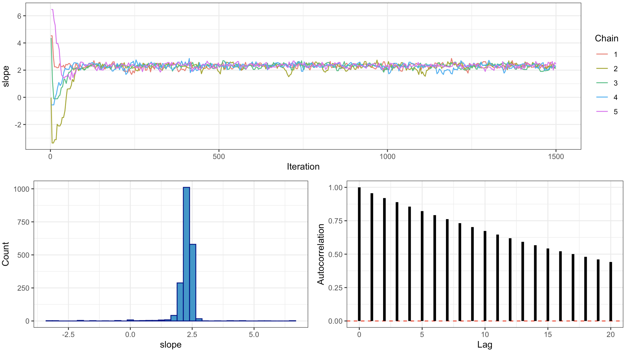
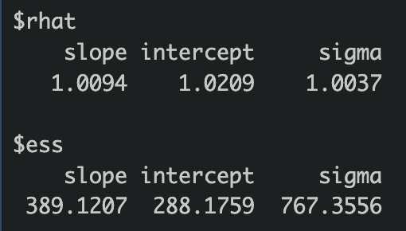
Assessing behavior
plot_trace()
MCMC diagnostics

Slide 11
Challenges
Try fiddling with the priors. What happens if you give sigma a normal prior going from -Inf to Inf?
Try adding a quadratic term
Try making a linear model in terms of both Girth and Height

